Slide 1
C++ Programming Design
Session #1

Slide 2
#1 Getting Started with C++
OOP and C++
History of C++
C vs C++
Tools
Linux
G++
Environment setup

Slide 3
OOP (Object-Oriented programming)
Object means a real word entity such as pen, chair, table etc. Object-Oriented Programming is a methodology or paradigm to design a program using classes and objects. It simplifies the software development and maintenance by providing some concepts:
Object
Class
Abstraction
Encapsulation
Inheritance
Polymorphism

Slide 4
OOP (Object-Oriented programming)
Object
Any entity that has state and behavior is known as an object. For example: chair, pen, table, keyboard, bike etc. It can be physical and logical.

Slide 5
OOP (Object-Oriented programming)
Class
It is a user defined data type, which holds its own data members and member functions, which can be accessed and used by creating an instance of that class. A class is like a blueprint for an object.
For Example: Consider the Class of Cars. There may be many cars with different names and brand but all of them will share some common properties like all of them will have 4 wheels, Speed Limit, Mileage range etc.

Slide 6
OOP (Object-Oriented programming)
Class and object

Slide 7
OOP (Object-Oriented programming)
Abstraction
Data abstraction refers to providing only essential information to the outside world and hiding their background details, i.e., to represent the needed information in program without presenting the details.
Data abstraction is a programming (and design) technique that relies on the separation of interface and implementation.

Slide 8
OOP (Object-Oriented programming)
Abstraction
Example: You don’t fully know how you computer works. There are I/O (keyboard, screen, speakers) you can interact with and if you can add/remove RAM, your user experience will stay the same.

Slide 9
OOP (Object-Oriented programming)
Encapsulation
Encapsulation is an Object Oriented Programming concept that binds together the data and functions that manipulate the data, and that keeps both safe from outside interference and misuse. Data encapsulation led to the important OOP concept of data hiding.

Slide 10
OOP (Object-Oriented programming)
Encapsulation
Data encapsulation is a mechanism of bundling the data, and the functions that use them and data abstraction is a mechanism of exposing only the interfaces and hiding the implementation details from the user.

Slide 11




OOP (Object-Oriented programming)
class Minion
data
Name;
HairColor;
EyeNumber;
……
Abstraction
Encapsulation
GetName();
CountEyeNum();
SetHairColor();
……
Object
Class
manipulation

Slide 12



OOP (Object-Oriented programming)
Abstraction
Instantiation
Object
Class
Object
In real world
In program world

Slide 13
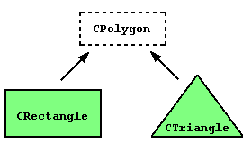
OOP (Object-Oriented programming)
Inheritance
Classes can be extended, creating new classes which retain characteristics of the base class. This process, known as inheritance, involves a base class and a derived class: The derived class inherits the members of the base class, on top of which it can add its own members.

Slide 14
OOP (Object-Oriented programming)
Polymorphism
The word polymorphism means having many forms. Typically, polymorphism occurs when there is a hierarchy of classes and they are related by inheritance.
Polymorphism means that a call to a member function will cause a different function to be executed depending on the type of object that invokes the function.

Slide 15
OOP (Object-Oriented programming)
Who is using OOP?
Well… Lot of languages:
C++
Java
Python
PHP
JavaScript
etc...

Slide 16
C++
Joins three separate programming categories:
(1)The procedural language, represented by C;
(2)The object-oriented language, represented by the class enhancements C++ adds to C;
(3)Generic programming, supported by C++ templates.

Slide 17
History of C++
The C Language : In the early 1970s
Dennis Ritchie of Bell Laboratories
UNIX
C Programming Philosophy: Procedural and structural programming

Slide 18
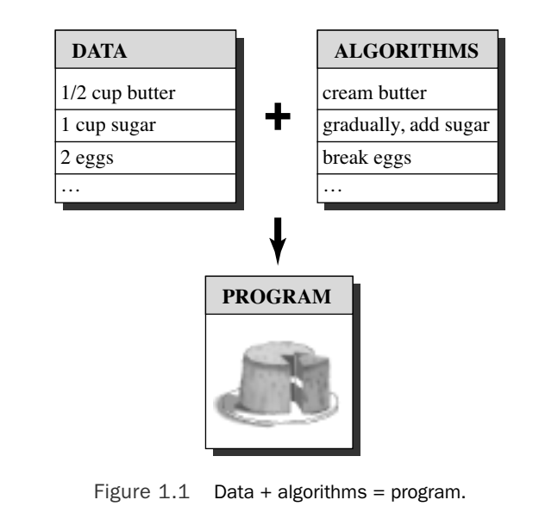
History of C++

Slide 19
History of C++
C++ is a programming language developed at AT&T Bell Laboratories by Bjarne Stroustrup in the early 1980's.
The language was designed with the intent of merging the efficiency and conciseness of C with the object-oriented programming features of SIMULA-67.

Slide 20
History of C++
C++ and its support for object-oriented programming provide a new methodology for designing, implementing and ease of maintaining software projects which C, a structured programming language, is unable to support.

Slide 21
History of C++
While C++ is similar to C in syntax and structure, it is important to realize that the two languages are radically different.

Slide 22
History of C++
Since its creation, the language has evolved rapidly and several new features have been added since its initial release in 1985.
The language also promises to provide support for several other useful mechanisms such as parameterized types and exception handling in the near future.

Slide 23
History of C++
Extensive libraries are available for the C programming language; consequently, a deliberate effort was made on behalf of the developers of C++ to maintain backward compatibility with C.
Any major deviation from the C programming language would have meant that all the libraries available for C would have to be tediously rewritten for C++. This would have severely limited the usefulness of C++ in an environment where C libraries were used extensively.

Slide 24
History of C++
Timeline:
1979
Stroustrup starts to work on “C with Classes” in Bell Labs
1983
“C with classes” renamed C++
1985
The first edition of the “The C++ programming language”
1989
C++ 2.0 version
1998
The first ISO Standards (C++98)

Slide 25
History of C++
Timeline:
2003
C++ 03, bug fixes of C++98
2011
C++11, a major revision
2014
C++14, bug fixes and small improvement
2017
C++17, a major version
2020
C++20, latest bug fixes version

Slide 26
History of C++
The C++ language has two main components:
A direct mapping of hardware features provided primarily by the C subset
zero-overhead abstractions based on those mappings.
Stroustrup describes C++ as "a light-weight abstraction programming language designed for building and using efficient and elegant abstractions; and offering both hardware access and abstraction is the basis of C++. Doing it efficiently is what distinguishes it from other languages.

Slide 27
History of C++
If you are familiar with Java, PHP or Python, you will find that C++ is a bit harder to use since you need to manually manage memory allocation of your program.

Slide 28
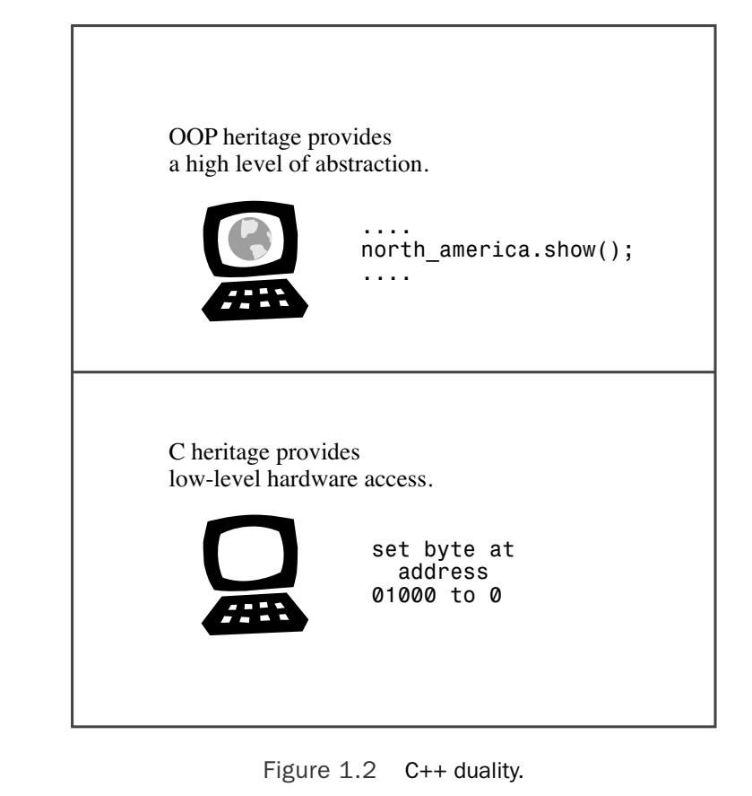
C vs. C++

Slide 29
C vs C++
C is generally considered to be the foundation of many modern high-level programming languages like C# and Java.
C++ language is one of those an enhanced version of the language that adds an object-oriented layer, which definitely boosts developer speed and productivity.

Slide 30
C vs C++
Most of the “kernels” available are written in C or C++, because the speed of execution and it allows developer to work closely with the hardware.

Slide 31
C vs C++
A BIT ABOUT C
C is a system programming language, whereas C++ is a general-purpose programming language commonly used in embedded systems. C is procedural, so it doesn’t support classes and objects like C++ does (although, despite being object-oriented, C++ can be procedural like C, making it a bit more hybrid).

Slide 32
C vs C++
A BIT ABOUT C++
C++ was created in the 1980s and has been used in the creation of desktop and web applications, although it’s most popular for applications such as games, operating systems, and low-level hardware programming for a PC or server.

Slide 33
C vs C++
To make it simple (1 / 4):
C++ is directly derived from the C language. This means it shares some properties with C while also adding some improvements.
C++ is object-oriented. This translates to productivity and organization of code, which is a boon for more complex applications. It’s great for fast applications and server-side software.

Slide 34
C vs C++
To make it simple (2 / 4):
C++ is lightweight and compiled. This means that before a C++ application is launched on a PC or the server, the code is converted into a binary file, or an executable .EXE file. C++ compiled files are pretty lightweight vs. files with more overhead, like C#. With C++, you can code for any platform including Mac, Windows and Linux.
It has benefits of both high-level and low-level programming languages. This makes it more of a mid-level language.

Slide 35
C vs C++
To make it simple (3 / 4):
The power of C++ lies in its performance and speed. This makes it ideal for complex, large applications that require a lot of speed at scale.
C++ plays well with other languages. Because it can interface with nearly any other language, C++ is a great option. And, almost any system can compile and run C++ code.

Slide 36
C vs C++
To make it simple (4 / 4):
Pointers equal productivity. A “pointer” is a feature of C++ (and other C-based languages) that allows developers to simplify code. A pointer represents an “address” where a piece of data exists, so you code the location of a variable, not the whole variable.

Slide 37
C vs C++
To make it simple (4 / 4):
Think of pointer this way: Instead of personally handing out newsletters to everyone in your company, you put the newsletters in a mailbox and tell everyone where the mailbox is located. Or, if you’re dealing with a large bit of data, think of a pointer like giving someone your address, rather than giving them your whole house. It’s a logic for computing—one we use every day as humans.

Slide 38
C vs C++
When Should You Use Which Language?
If you want an application that works directly with computer hardware or deals with application development, C++ is a good option.
C++ programs include server-side applications, networking, gaming, and even device drivers for your PC. However, if you need to code truly tiny systems, using C will result in a little less overhead than C++.

Slide 39
C vs C++
When Should You Use Which Language?
C++ is well-rounded in terms of platforms and target applications, so if your project is focused on extremely low-level processing, then you may want to use C++.

Slide 40
Why Learn C++?

Slide 41
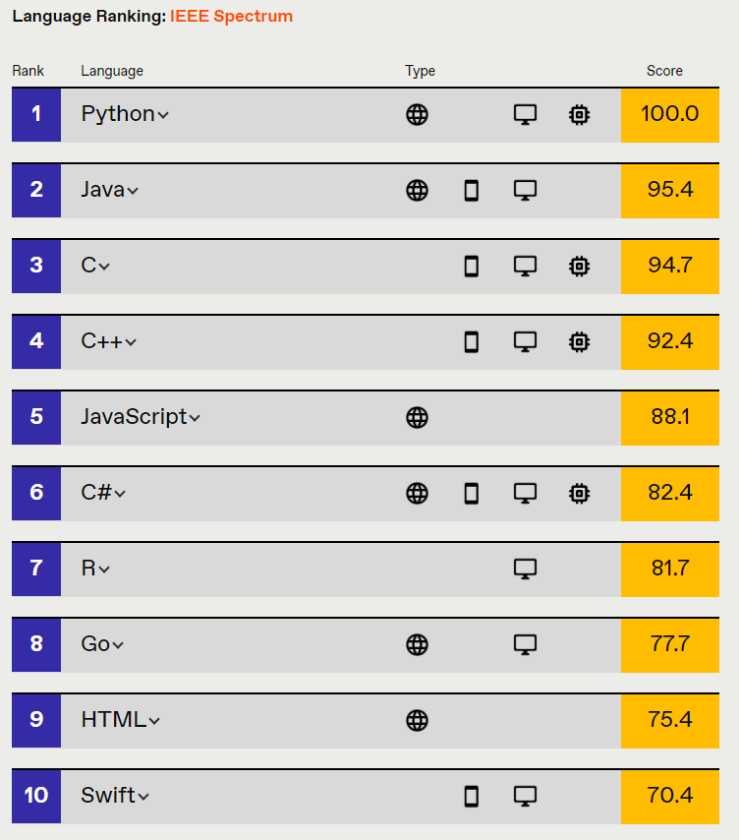
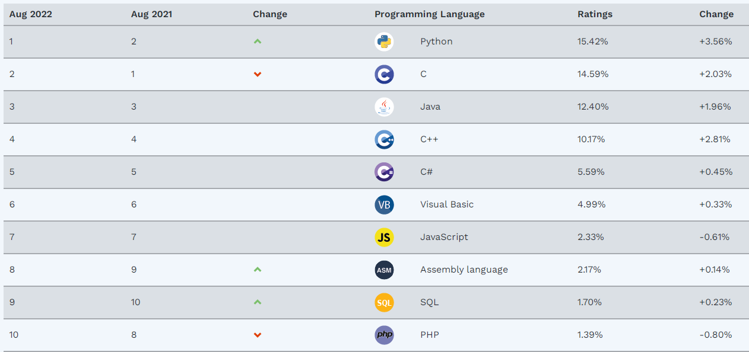
Why Learn C++?
IEEE Spectrum 2022
TIOBE 2022

Slide 42
Why Learn C++?
Pros:
Scalability C++'s greatest strength is how scalable it could be, so apps that are very resource intensive are usually built with it. Graphics require a lot of resource, which is why the most beautiful 3D games you happily feast your eyes on are often built with C++.

Slide 43
Why Learn C++?
Pros:
Fast As a statically typed language, C++ is generally more performant than dynamically typed languages because the code is type-checked before it is executed. Java is gaining ground in terms of speed, but in the end, depending on how talented the C++ developer is, C++ can still be faster than Java.

Slide 44
Why Learn C++?
Pros:
Community(1/2) First of all, community size is important, because the larger a programming language community is, the more support you'd be likely to get. As you step into the programming world, you'll soon understand how vital support is, as the developer community is all about giving and receiving help.

Slide 45
Why Learn C++?
Pros:
Community(2/2) Moreover, the larger a community, the more people will be building useful tools to make development in that particular language easier. As of now, there are over 600 notable programming languages world-wide.

Slide 46
Why Learn C++?
Pros:
Control As mentioned before, since you have a lot of control over how your app uses resources, your app can take up very little resource. All in all, since C++ can be very performant in the right hands, enterprises often use C++ to code functions that have a critical reliance on speed and resource usage.

Slide 47
Why Learn C++?
Cons:
Very Complex(1/2) Since C++ is rather lower level, the language is huge and you will need to handle a lot of complex things such as memory management and more. You also need to write a lot of code before you can get a working prototype if you're planning on building an app from scratch. Since it will be difficult to grasp how all features in C++ works, you can easily shoot yourself in the foot.

Slide 48
Why Learn C++?
Cons:
Very Complex(2/2) As such, since it's easy for a coding beginner to go astray when learning C++, we strongly recommend learning C++ with a mentor.

Slide 49
Why Learn C++?
Cons:
Not Easy To Maintain(1/2) C++ needs a lot of code, which means you need a large team to scale a C++ app, and from a time and financial investment point of view, C++ not easy to scale.
Also, since you have to do a lot of things manually with C++, it's easy for less experienced or less skilled developers to introduce errors into the code base.

Slide 50
Why Learn C++?
Cons:
Not Easy To Maintain(2/2) Java was developed because so many professional developers were making mistakes, so in terms of talent-recruiting, a very skilled and experienced C++ developer may be hard to find and also expensive to afford, which is why C++ is not so scalable.

Slide 51
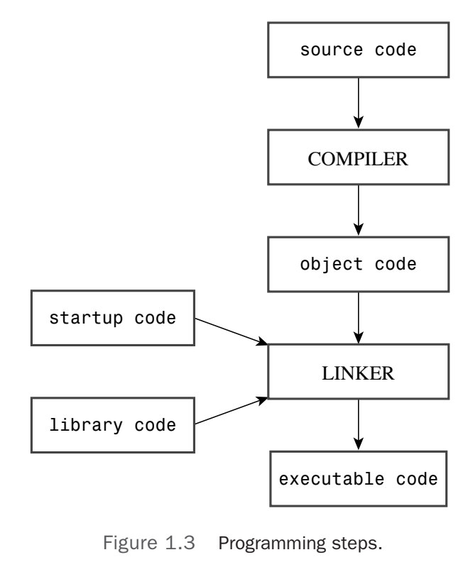
The Mechanics of Creating a Program

Slide 52
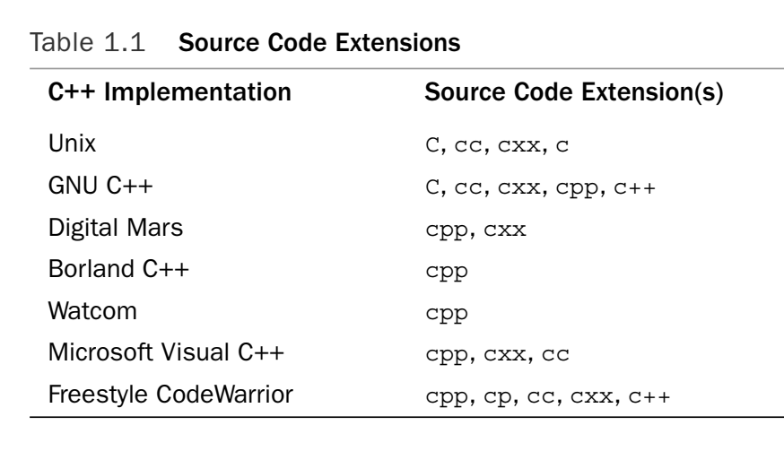
Source Code Extensions

Slide 53
Linux
Command line
Shell script
Make
G++

Slide 54
Linux
FEW companies are NOT using linux to run their applications. If you have never used it, I highly encourage you to start as soon as possible.

Slide 55
Linux
Virtual Machine (VM)
Your computer needs at least 2GB Ram if you run the desktop
You can clone the system
Dual Boot
Faster
Try to not break the system

Slide 56
Linux
Terminal
CD -> change directory
LS -> list directory
PWD -> current path
NANO/VIM/GEANY -> text editors

Slide 57
Linux
Are there any good IDE on Linux?

Slide 58
Linux
Yes, a lot

Slide 59
Linux
Should I use it?

Slide 60
Linux
No

Slide 61
G++
The GNU Compiler Collection is a compiler system produced by the GNU Project supporting various programming languages. GCC is a key component of the GNU toolchain and the standard compiler for most Unix-like operating systems.

Slide 62
G++
G++ will parse your source code to generate a binary file. You can do this operation like this:
$> g++ filename.cpp -o outputfile
Then
$> ./outputfile

Slide 63
G++
If you can’t run this command on your system, then run the command:
$> sudo apt-get install g++

Slide 64
G++
Explaining how g++ works is a totally different topic that we can’t fully cover, if you want to get more details, look for it on Internet or run:
$> man g++
There are nearly 22K lines of documentation.

